Slide 1

List Interface

Slide 2
Contents
List
ArrayList
Linkedlist
Vector

Slide 3

Why do we need List??

Slide 4
List Interface
An interface that extends the Collection interface.
An ordered collection (also known as a sequence).
The user of this interface has precise control over where in the list each element is inserted.
The user can access elements by their integer index (position in the list), and search for elements in the list.
Unlike Set, allows duplicate elements.
Provides a special Iterator called ListIterator for looping through elements of the List

Slide 5
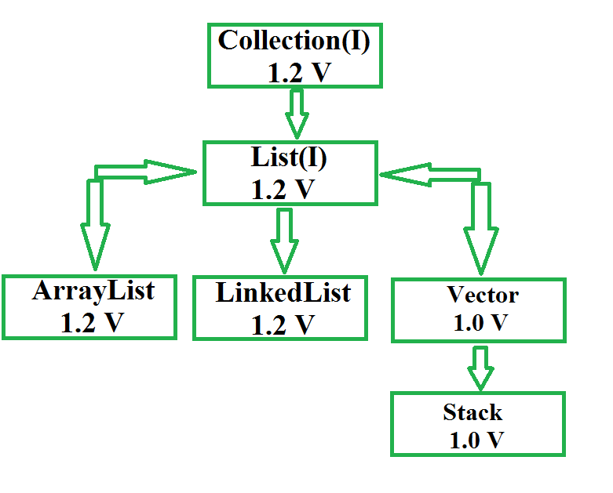
List Interface extends Collection, hence it supports all the operations of Collection Interface

Slide 6
Creating List Objects:
List a = new ArrayList();
List b = new LinkedList();
List c = new Vector();
List d = new Stack();
After the introduction of Generics in Java 1.5, it is possible to restrict the type of object that can be stored in the List.
List<Obj> list = new ArrayList<Obj> ();

Slide 7
Additional methods in List Interface
List extends Collection with additional methods for performing index-based operations:
void add(int index, Object element)
boolean addAll(int index, Collection collection)
Object get(int index)
int indexOf(Object element)
int lastIndexOf(Object element)
Object remove(int index)
Object set(int index, Object element)

Slide 8
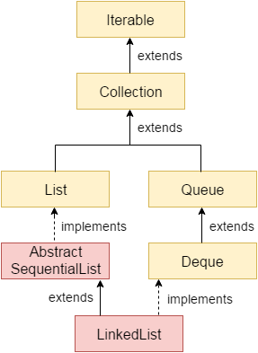
LinkedList Class
The LinkedList class offeres a few additional methods for directly manipulating the ends of the list:
void addFirst(Object)
void addLast(Object);
Object getFirst();
Object getLast();
Object removeFirst();
Object removeLast();
These methods make it natural to implement other simpler data structures, like Stacks and Queues.

Slide 9
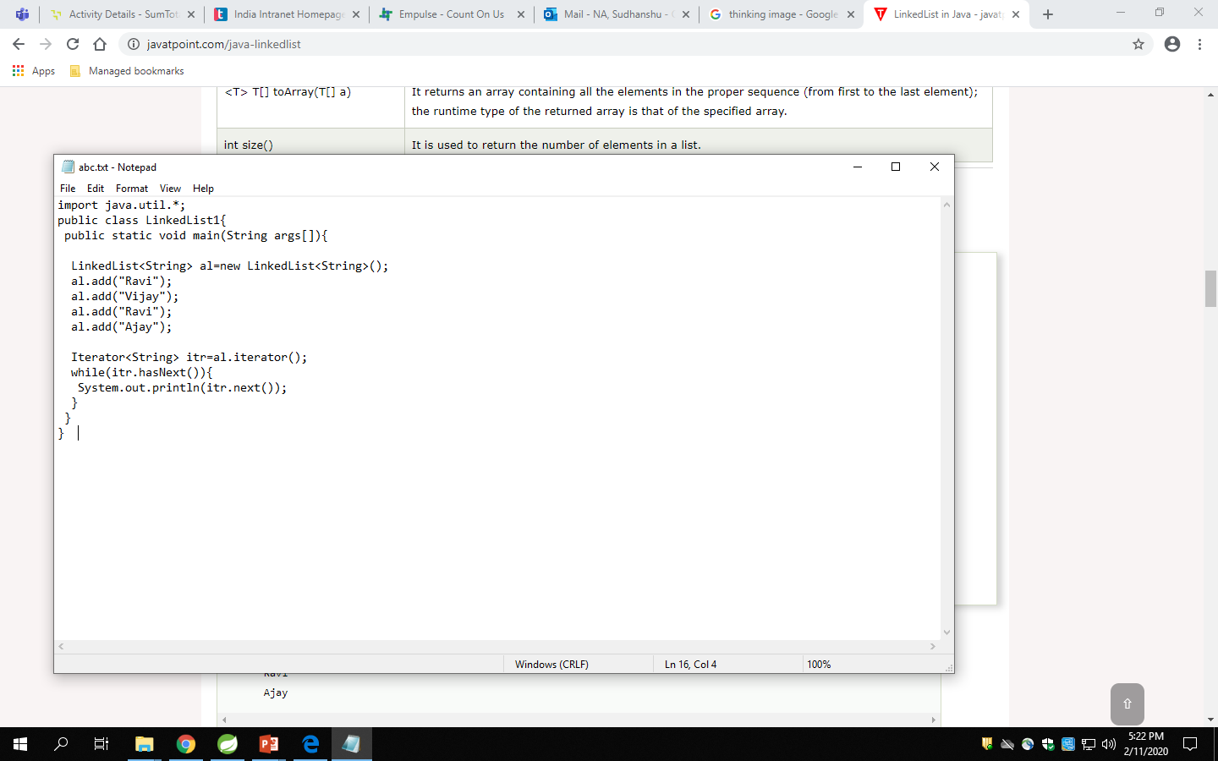

How to Implement LinkedList

Slide 10
ArrayList Class
ArrayList inherits AbstractList class and implements List interface.
ArrayList is initialized by a size, however the size can increase if collection grows or shrunk if objects are removed from the collection.
Java ArrayList allows us to randomly access the list.
ArrayList can not be used for primitive types, like int, char, etc. We need a wrapper class for such cases (see this for details).
ArrayList in Java can be seen as similar to vector in C++.

Slide 11
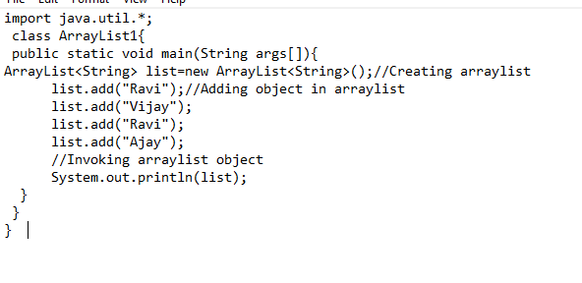
How to Implement ArrayList

Slide 12
Vector
The Vector class implements a growable array of objects. Vectors basically fall in legacy classes but now it is fully compatible with collections.
Vector implements a dynamic array that means it can grow or shrink as required. Like an array, it contains components that can be accessed using an integer index
They are very similar to ArrayList but Vector is synchronised and have some legacy method which collection framework does not contain.
It extends AbstractList and implements List interfaces.

Slide 13
Lets Recall ……
Why do we need list?
List Interface
Methods in List interface
Arraylist Class
Vector

